Slide 1

Automatic Text Summarization
Group 5
Final Results

Slide 2
Content
Situation
Task
Action
Result

Slide 3
Situation

Slide 4
multi document summarazation
Situation
Task
Action
Result
sth about related work and whats going on in multi document summarization

Slide 5
Task

Slide 6
hierarchical approach
Situation
Task
Action
Result
desctiption of the task with the hierarchical model and the

Slide 7
Action

Slide 8
Step 1
Situation
Task
Action
Result
finding nuggets

Slide 9
Step 2
Situation
Task
Action
Result
sorting nuggets

Slide 10
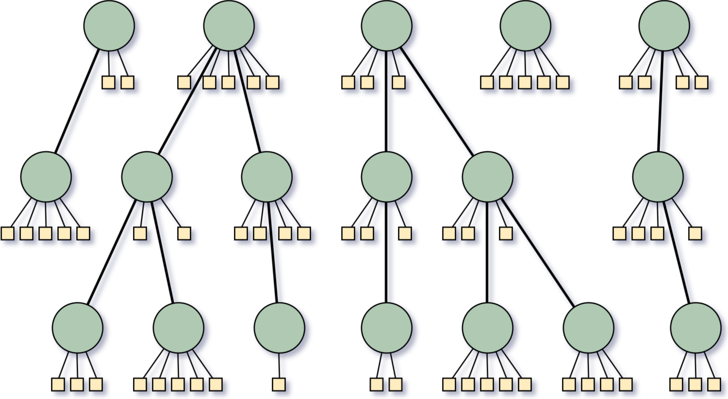
Step 3 – Creating summaries from hierarchies
Situation
Task
Action
Result

Slide 11
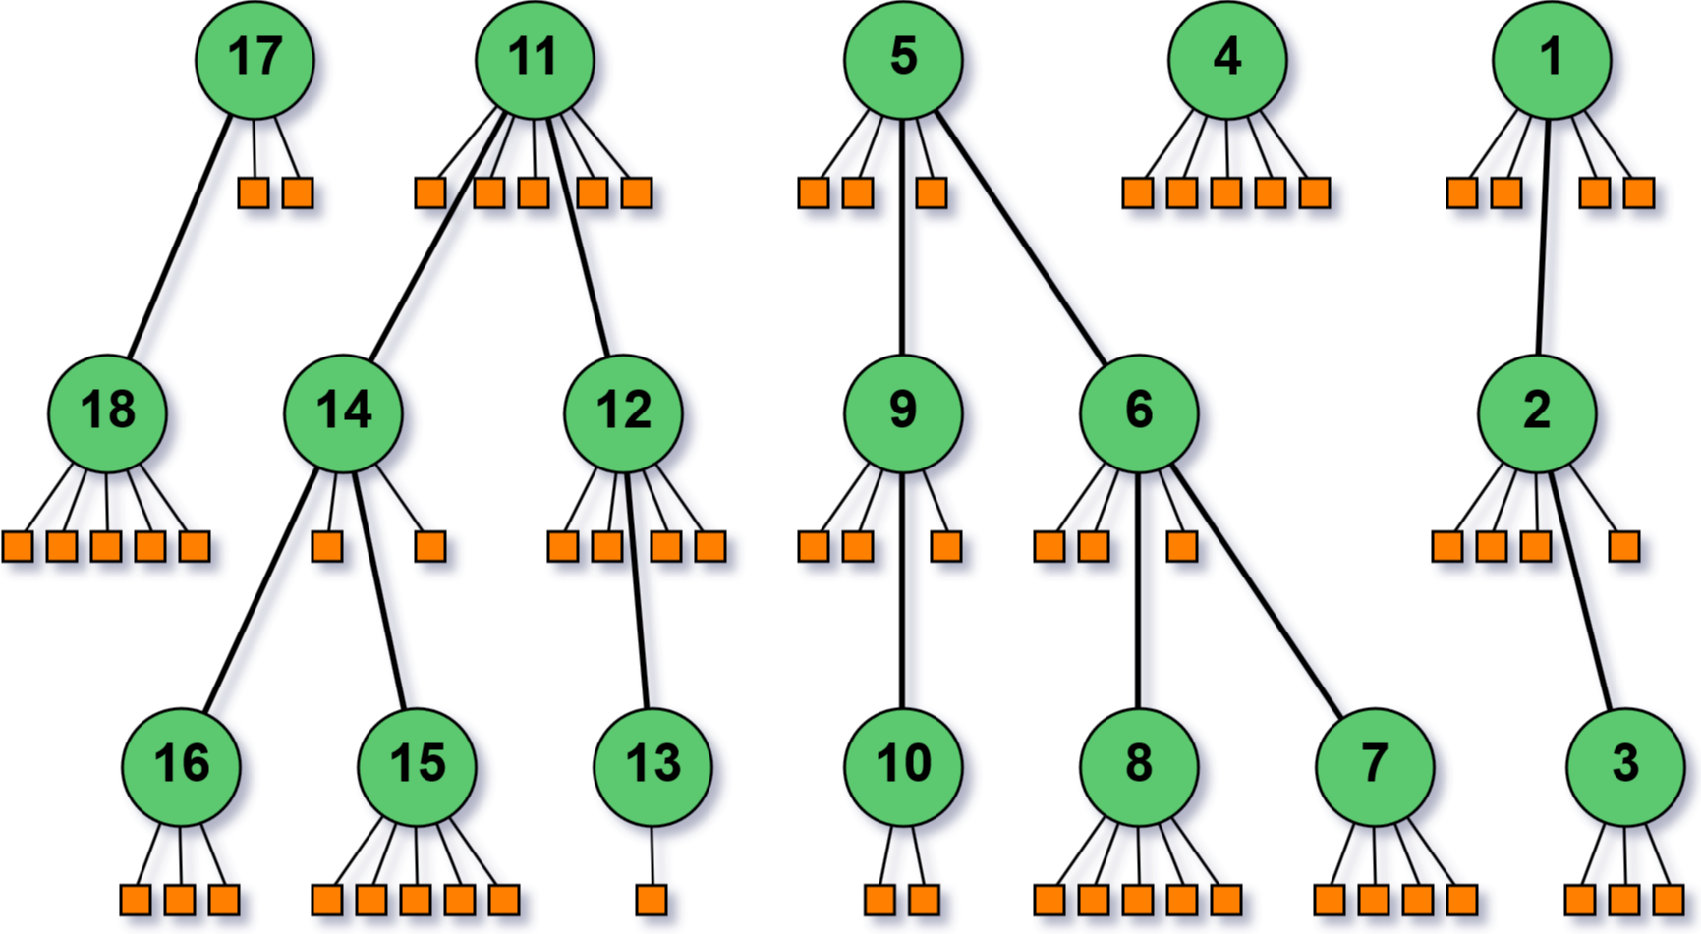
Step 3 – Creating summaries from hierarchies
Situation
Task
Action
Result
first approach: Iterate in depth-first search order over the nuggets

Slide 12
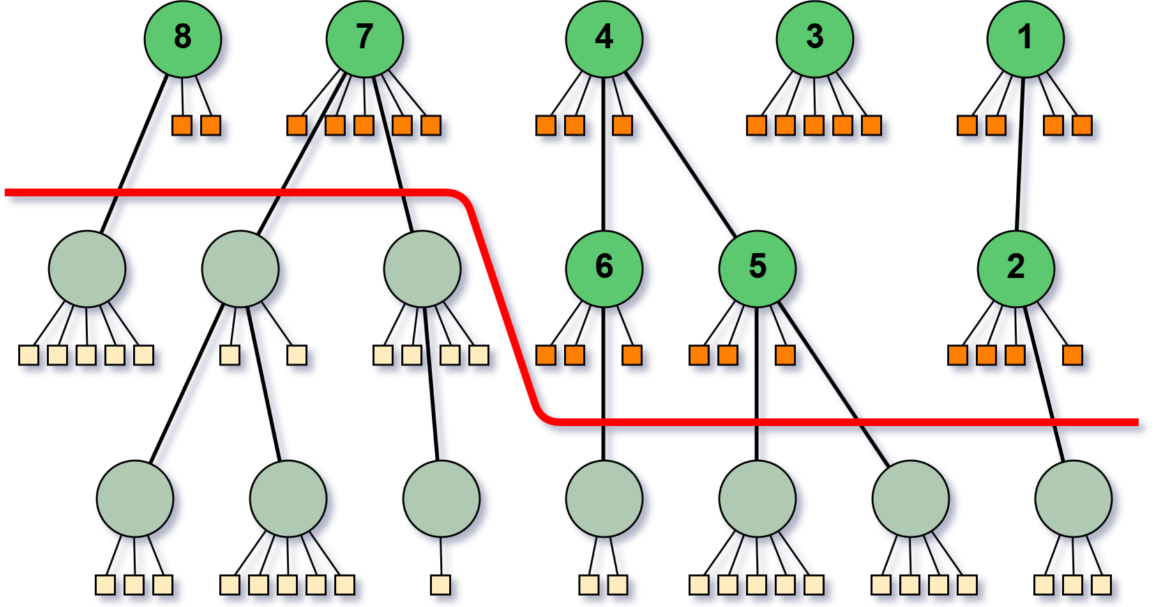
Step 3 – Creating summaries from hierarchies
Situation
Task
Action
Result
cut layers off to get shorter summaries

Slide 13
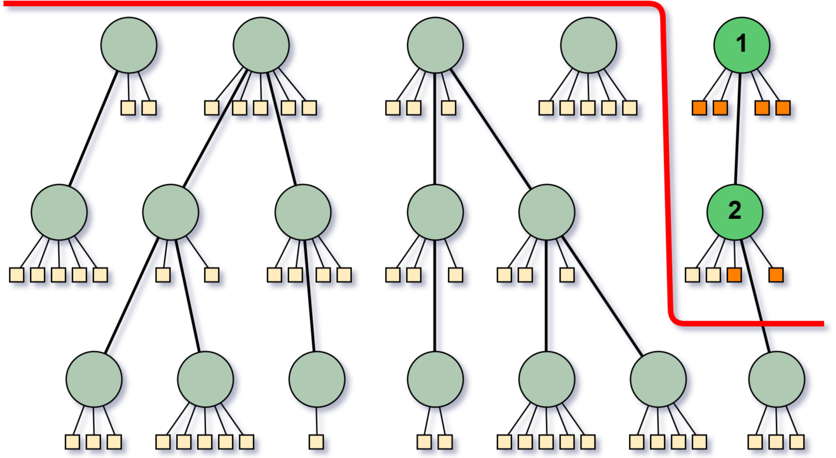
Step 3 – Creating summaries from hierarchies
Situation
Task
Action
Result
problem when summaries are very short

Slide 14
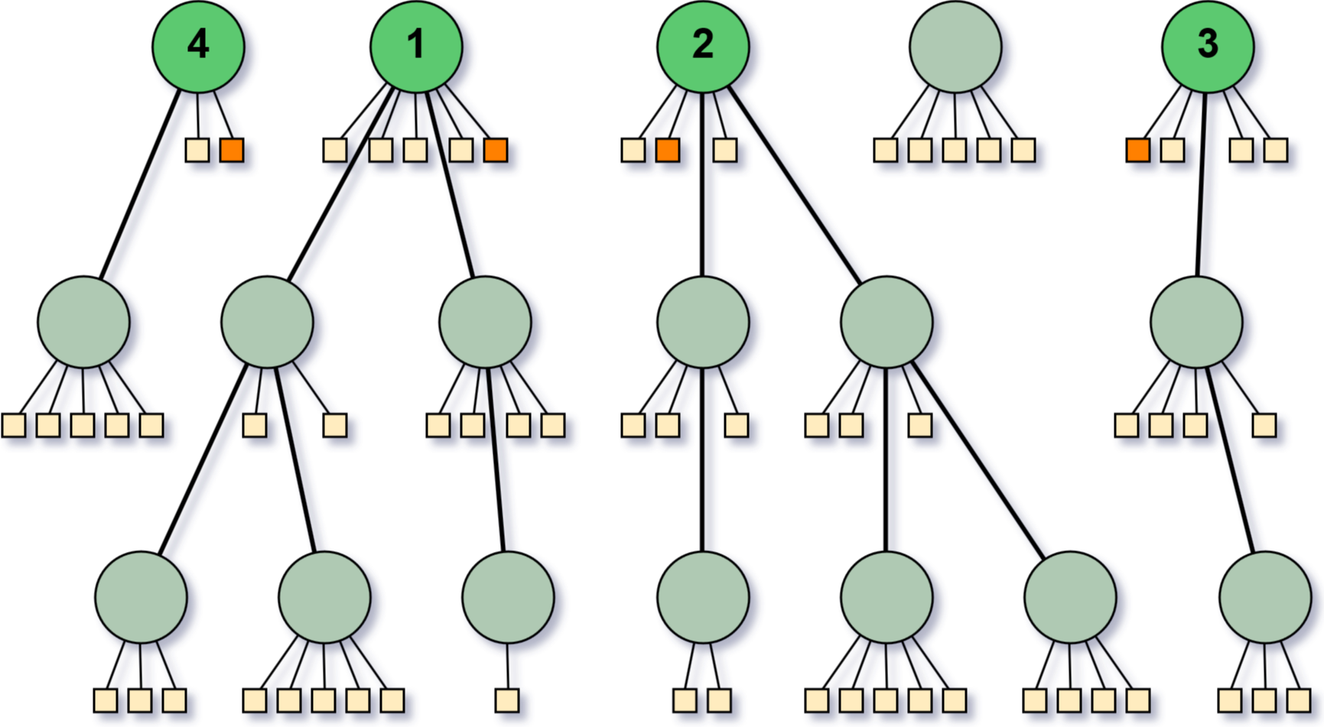
Step 3 – Creating summaries from hierarchies
Situation
Task
Action
Result
select shortest sentences from root bubbles of the largest trees

Slide 15
Step 3 – Creating summaries from hierarchies
Situation
Task
Action
Result
Baseline Text
Tool
Summary

Slide 16
Step 3 – Creating summaries from hierarchies
Situation
Task
Action
Result
Gensim Summarizer
Implements variation of TextRank algorithm
Did not work well at all!
Baseline Text
Tool
Summary

Slide 17
Step 3 – Creating summaries from hierarchies
Situation
Task
Action
Result
Sumy summariezers
Implementations of KL divergence, LexRank, LSA, Luhn algorithm, TextRank, …
Some produced barely acceptable output
Baseline Text
Tool
Summary
Notes:
Luhn: um so mehr wichtige Wörter in einem Satz, desto wichtiger für Zusammenfassung

Slide 18
Step 3 – Creating summaries from hierarchies
Situation
Task
Action
Result
Summa summarizer
Also implementation of TextRank…
But with optimized similarity funktion
Worked really well for many topics
Baseline Text
Tool
Summary
Notes:
Original TextRank calculates similarity between sentences based on common words
plus divided by length -> no promotion of long sentences
Optimization: similarity by BM25

Slide 19
Step 3 – Creating summaries from hierarchies
Situation
Task
Action
Result
Problem
Implementations mostly based on word count, sentence count or ratios
Never on character count

Slide 20
Step 3 – Creating summaries from hierarchies
Situation
Task
Action
Result
Solutuion
Sett word count so that approximately 600 characters are reached
Cut those sentences leading to more than 600
Adding sentences from hirarchy starting from the top level bubbles
make sure there are no duplicates
Notes:
Would have maybe been better to search for the bubble containing the last sentence in hirarchy and start adding sentences from there for more concurrency

Slide 21
Step 3 – Creating summaries from hierarchies
Situation
Task
Action
Result
Observation that there are many definition sentences!
„ADHD is a brain-based disorder where the chemistry of the brain (neurotransmitters) is not functioning as it should.„
Extract
Add as first
sentence

Slide 22
Result

Slide 23
evaluation
Situation
Task
Action
Result
each of our summaries were evaluated by at least 4 raters

Slide 24
Thank You for your attention

